Slide 1


One Size Does Fit All: Exploring Model Fusion for Software Engineering Tasks
Yinggang Qiu, Yihao Qin, Mingyang Geng,
Shangwen Wang, Dezun Dong
College of Computer Science and Technology
National University of Defense Technology, China
2026-7-8, Wednesday, @FSE 2026
Notes:
Good afternoon, everyone. Today I will present our work, “One Size Does Fit All: Exploring Model Fusion for Software Engineering Tasks.”

Slide 2
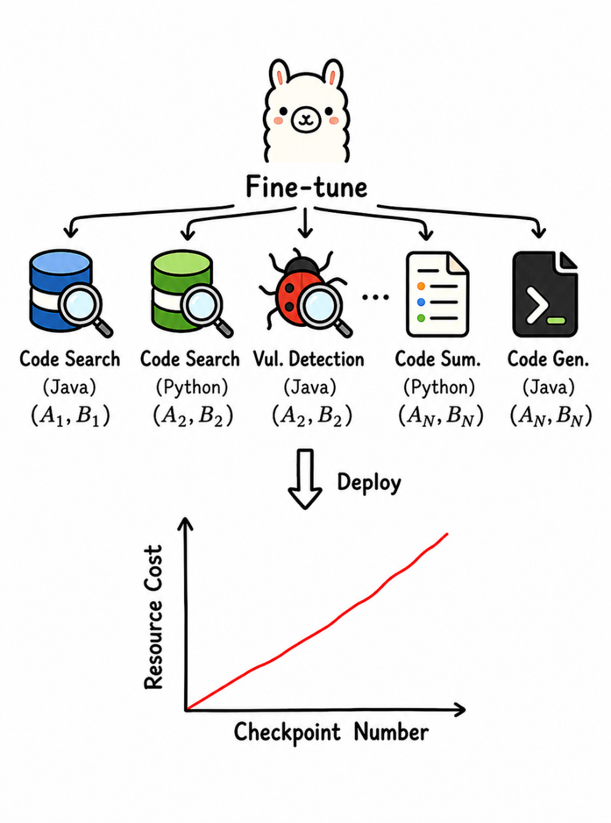
1. Background
Fine-tuning Paradigm
One checkpoint is fine-tuned for each SE task and PL.
Difficulties in checkpoint management
High deployment complexity
Notes:
Let me first introduce the background. fine-tuning for Large language models has gradually become a common paradigm for downstream tasks.
In software engineering, we often fine-tune and deploy separate models for different tasks and programming languages.
However, when many checkpoints need to be deployed, the required system resources grow almost linearly with the number of tasks. This significantly increases the cost of management and deployment.

Slide 3
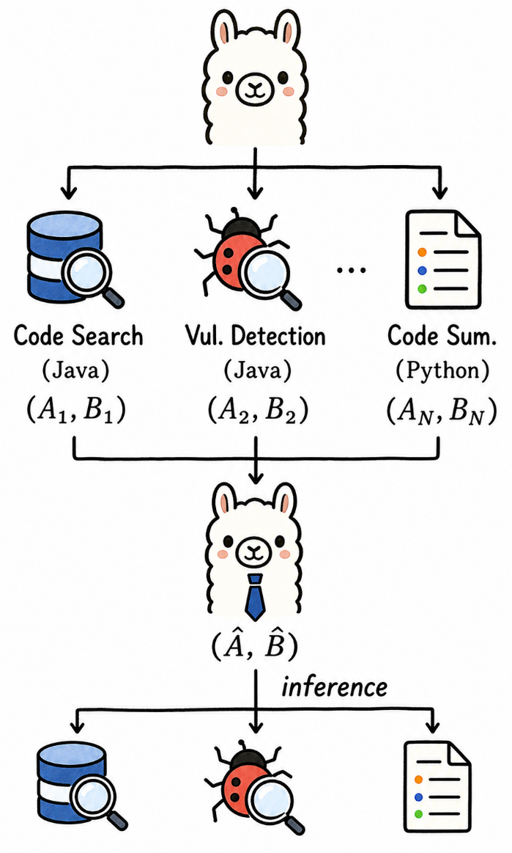
1. Background
1. Pre-trained Model
Use CodeLlama-7B as the base model for fine-tuning across all tasks.
2. Fine-tuning
For each tasks, train a separate low-rank adapters (LoRA ) checkpoint.
3. Model Fusion
Merge multiple LoRA checkpoint into a single fused parameter set using a model fusion algorithm.
4. Inference
Load the fused parameters back into the base model and evaluate the fusion performance.
Notes:
Model fusion has emerged as a promising approach. It aims to merge multiple fine-tuned checkpoints into a single checkpoint, and the merged model can handle the corresponding tasks simultaneously.
Model fusion has shown strong performance in computer vision and natural language processing. However, its effectiveness in software engineering is still underexplored.
Therefore, the main question of our work is: can model fusion enable one unified model that can efficiently support multiple software engineering tasks and programming languages?
To answer this question, our workflow is as follows.
First, we use CodeLlama-7B as the base model and fine-tune with LoRA for each software engineering task and programming language.
Then, we apply model fusion approaches to the LoRA parameters.
Finally, we load the fused LoRA parameters into the base model for inference and evaluate the fusion performance.

Slide 4


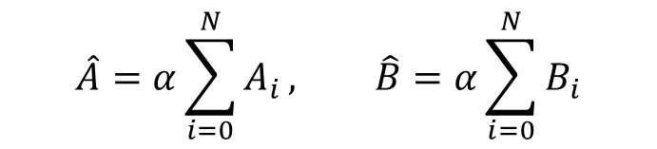
2. Study Design
Selected Model Fusion Approach
Task Arithmetic [1]
Ties-merging [2]
Task A
Task B
Fused Params
$${(A}_{1},B_{1})$$
Normal
Redundant Parameter
sign conflict
$${(A}_{2},B_{2})$$
Ties-merging
$$\hat{A}=α\sum_{i=0}^{N}{A_{i}}, \hat{B}=α\sum_{i=0}^{N}{B_{i}}$$
Remove Redundancy: Keep only the top k% largest parameters.
Resolve sign conflicts: Retain only parameters consistent with the majority sign direction.
Average: Average only the non-zero parameters.
Treat fine-tuned parameters as vectors.
[1] Gabriel Ilharco et al. 2022. Editing models with task arithmetic. arXiv preprint arXiv:2212.04089 (2022).
[2] Prateek Yadav et al. 2023. Ties-merging: Resolving interference when merging models. Advances in Neural Information Processing Systems 36 (2023), 7093–7115.
Notes:
We mainly investigate four model fusion approaches.
The first is Task Arithmetic, which treats the fine-tuned LoRA parameters as task vectors. then obtain the fused parameters by summing these vectors and applying a scaling coefficient.
The second is TIES-Merging. It observes that directly adding task vectors can lead to two issues. The first is parameter redundancy: for some dimensions, a task may have only very small changes, but these values can still interfere with other tasks after averaging. That is the average value is small. The second issue is sign conflict, where different tasks may update in opposite directions.
To address these issues, TIES-Merging first keeps only the top-k parameters with the largest magnitudes for each task. Then, for each dimension, it retains only the parameters whose signs agree with the dominant sign and sets the others to zero. Finally, it averages the remaining non-zero parameters.

Slide 5

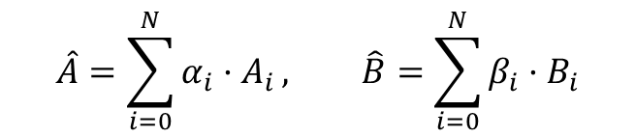



2. Study Design
Selected Model Fusion Approach
Learnable Fusion Coefficients[3]
TALL-Masks [4]
Task A
Task B
Fused Params
$$α_{1}.(A_{1},B_{1})$$
Mask Construction
$$α_{2}.(A_{2},B_{2})$$
$$m_{i}=1\left\{\left|p_{i}\right|≥|p_{fusion}−p_{i}|\right\}$$
Task A
$$\hat{A}=\sum_{i=0}^{N}{{α_{i}·A}_{i}}, \hat{B}=\sum_{i=0}^{N}{β_{i}·B_{i}}$$
Task B
If the gap between the fused parameters and task-specific parameters falls within a certain range, they are considered related.
Assign task-specific fusion coefficients to different task vectors.
Optimize the fusion coefficients through gradient descent.
Inference for task i
$$\hat{p_{i}}=m_{i}⊙p_{fusion}$$
[3] Enneng Yang et al. 2023. Adamerging: Adaptive model merging for multi-task learning. arXiv preprint arXiv:2310.02575 (2023).
[4] Ke Wang et al. Localizing task information for improved model merging and compression. arXiv preprint arXiv:2405.07813 (2024).
Notes:
The third is learnable fusion coefficients. Instead of treating all task vectors equally, it assigns a learnable coefficient to each task vector. then These coefficients are optimized through gradient descent to achieve better fusion performance.
The last is TALL-Masks. It introduces an additional mask for each task to identify the task-relevant parameters from the fused parameters.
In our implementation, we obtain the fused parameters using max fusion, which means that, for each dimension, we keep the value with the largest absolute magnitude along with its sign.
Then, for each task, We construct the mask using the formula shown here. The intuition is simple: if the difference between the fused parameter and the corresponding fine-tuned parameter is within a certain range, we consider that this dimension is relevant to the task and keep it.
During inference, for each task, we use the corresponding mask to extract the relevant parameters from the fused parameters for inference.

Slide 6
2. Study Design
Experiment Settings
Three program understanding tasks (code search, vulnerability detection and clone detection)
Three program generation tasks (code generation, code repair and code summarization)
Dataset statistics for RQ1.
Research questions (RQs)
Task | Code Search |  |  | Code Repair
 | Train | Validation | Test | Train | Test
Python | 412,178 | 23,107 | 22,176 | 461,356 | 710
Java | 454,451 | 15,328 | 26,909 | 574,448 | 716
Javascript | 123,889 | 8,253 | 6,483 | 8,861 | 183
Go | 317,832 | 14,242 | 14,291 | 13,085 | 294
Ruby | 48,791 | 2,209 | 2,279 | 5,153 | 343
PHP | 523,712 | 26,015 | 28,391 | 3,595 | 191
RQ1: How does multi-PL fusion perform within the same task?
RQ2: How does fusion perform across multiple SE tasks within the same PL?
RQ3: How does fusion perform across multiple tasks and multiple PLs?
RQ4: How can we improve the performance of model fusion techniques for SE tasks?
Dataset statistics for RQ2 and RQ3.
 | Language | Train | Validation | Test
Code Search | Java | 412,178 | 23,107 | 22,176
Vulnerability Detection |  | 70,008 | 7,825 | 7,135
Clone Detection |  | 901,058 | 415,416 | 415,416
Code Generation | Python | 50,661 | \ | 164
Code Repair |  | 461,356 | \ | 710
Code Summarization |  | 251,820 | 13,914 | 14,918
Normalized Accuracy (Metric for Model Fusion)：$N. Acc. =\frac{S_{fusion}}{S_{ft }}$
Notes:
To evaluate the effectiveness of these fusion approaches, we conduct experiments on three program understanding tasks and three program generation tasks,
We aim to answer four research questions.
First, how well does model fusion perform across multiple programming languages within the same task? To answer this question, we conduct experiments on code search and code repair tasks, and merge six popular programming languages.
Second question is how well does model fusion perform across multiple software engineering tasks within the same programming language, we separately merge three program understanding tasks and three program generation tasks.
Third question is how well does model fusion perform when merge both multiple tasks and multiple programming languages? We merge the all tasks studied in question 2 to evaluate this setting.
Finally, we improve existing approaches to further enhance the fusion performance.
For evaluation, we use normalized accuracy, which is defined as the ratio between the performance of the fused model and that of the fine-tuned model. A higher value indicates better fusion performance.

Slide 7
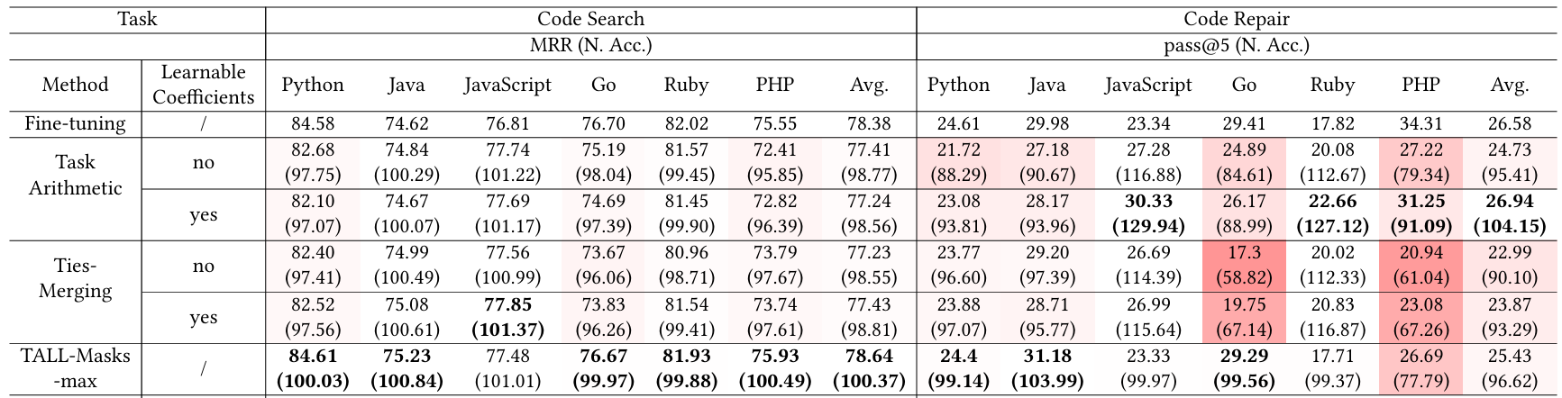
3. Study Result
RQ1: Performance of Multi-PL Fusion within Same Task
In code search, all methods maintain relatively good performance.
In code repair, all methods show a significant performance drop on Go and PHP.
Notes:
Let us first look at the first question, which studies multi-language fusion.
The depth of the red color indicates the degree of performance drop after fusion.
For the code search task, we can see that all approaches preserve performance very well, with over 98% of the original fine-tuned performance.
However, for the code repair task, almost all approaches suffer substantial performance drops on Go and PHP.

Slide 8
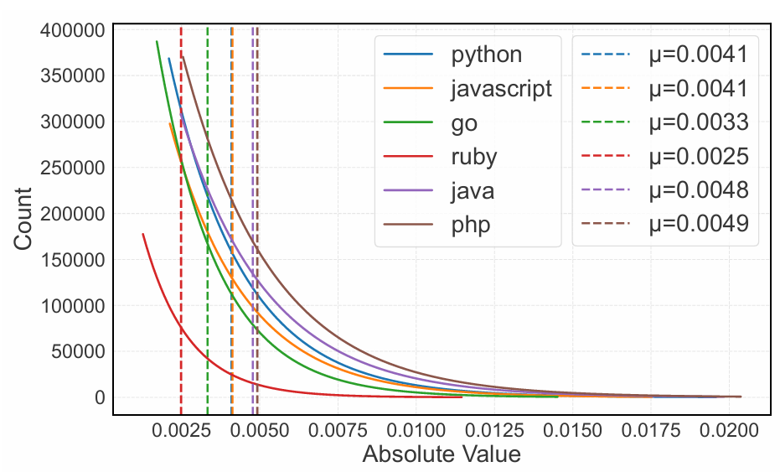
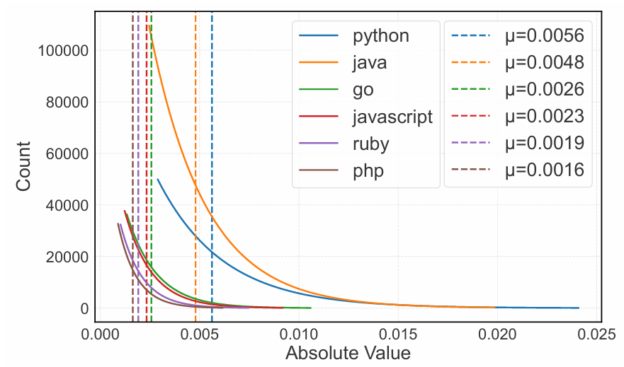
3. Study Result
RQ1: Performance of Multi-PL Fusion within Same Task
Code Search
Code Repair
For parameter change distribution differences across PLs, code search shows much smaller variation than code repair.
In code repair, performance drops usually occur on tasks with smaller parameter changes.
Notes:
To understand the reason behind this, we conduct the following analysis.
These two figures show the distributions of the absolute parameter changes for code search and code repair.
We can see that, for code search, the distributions across different languages are much more balanced than those for code repair. This is probably because the training data is more balanced across languages in the code search
As a result, the fused model can maintain strong performance on code search.
However， For code repair,, performance degradation usually occurs on tasks with smaller parameter changes, such as Go and PHP.

Slide 9
3. Study Result
RQ1: Performance of Multi-PL Fusion within Same Task
Performance improves on certain PLs.
Notes:
We also observe that, for some languages, fusion can even improve performance. For example, this happens for JavaScript in both code search and code repair.

Slide 10
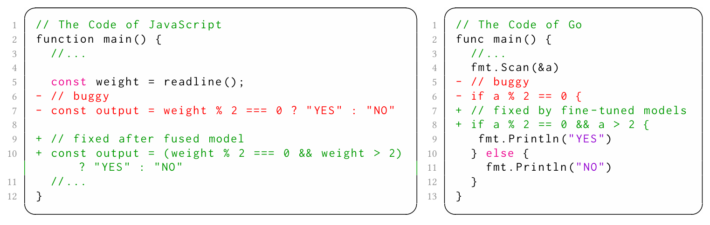
3. Study Result
RQ1: Performance of Multi-PL Fusion within Same Task
In the code repair task, when bugs share similarities, fusion can improve performance.
Notes:
Here we show an example from code repair. For JavaScript and Go, their test sets contain similar bug. However, the JavaScript’s fine-tuned model fails to fix the bug, while the Go’s fine-tuned model is successful to fix.
After fusion, the fused model successfully fixes the JavaScript bug.
This suggests that when samples from different languages share similar patterns, model fusion can transfer useful knowledge across languages and improve performance.

Slide 11
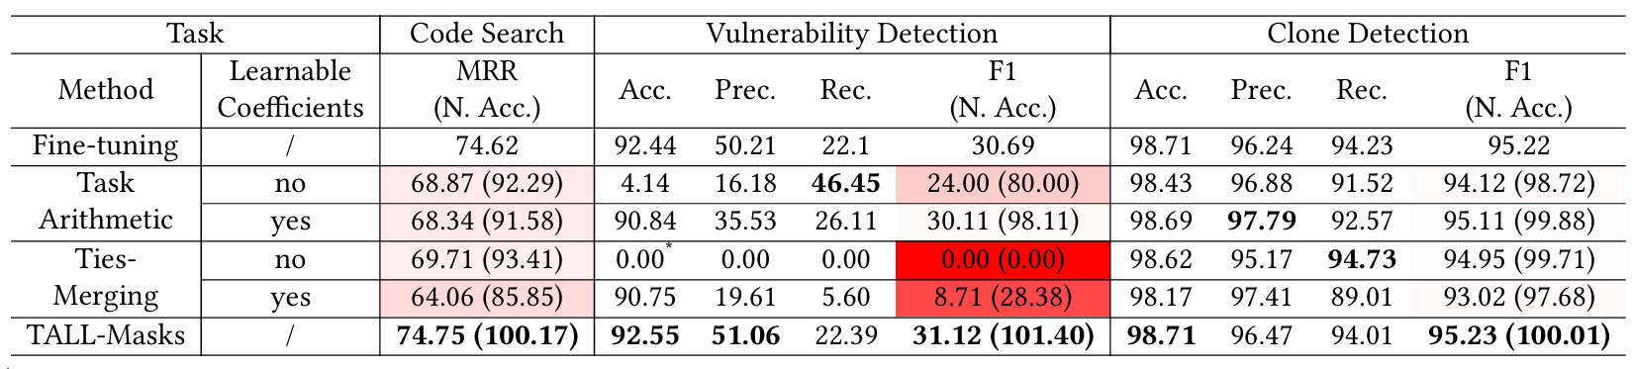
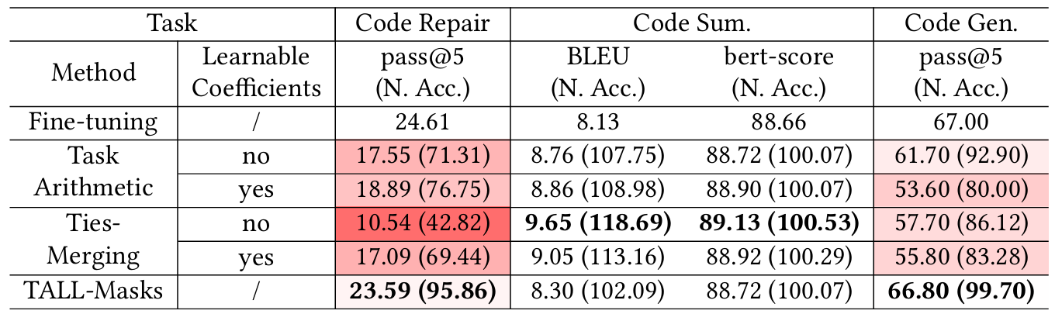
3. Study Result
RQ2: Performance of Multi-SE-Task Fusion within Same PL
Fusion Performance of Program Understanding Tasks (Java)
Fusion Performance of Program Generation Tasks (Python)
Except for TALL-Masks, other methods suffer significant performance losses on certain tasks.
All methods can maintain relatively good performance on certain tasks.
Notes:
Here shows the fusion performance for multiple task within the same PL
The two tables report the results for program understanding tasks in Java and program generation tasks in Python, respectively.
We can see that, on vulnerability detection and code repair, except TALL-Masks the other approaches suffer substantial performance drops. In contrast, for clone detection and code summarization, all approaches maintain very good performance.

Slide 12
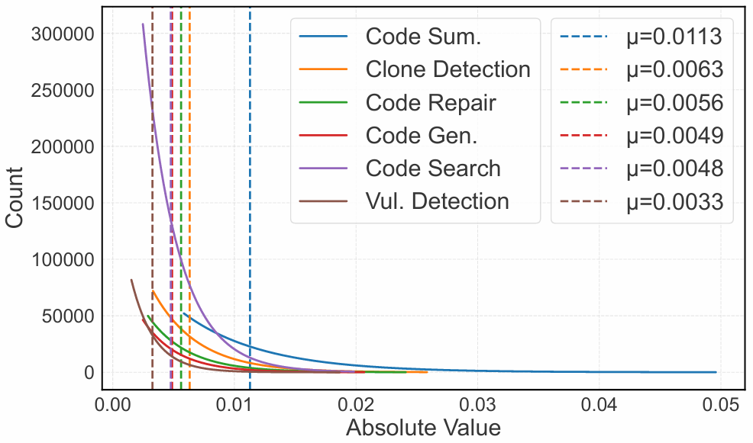
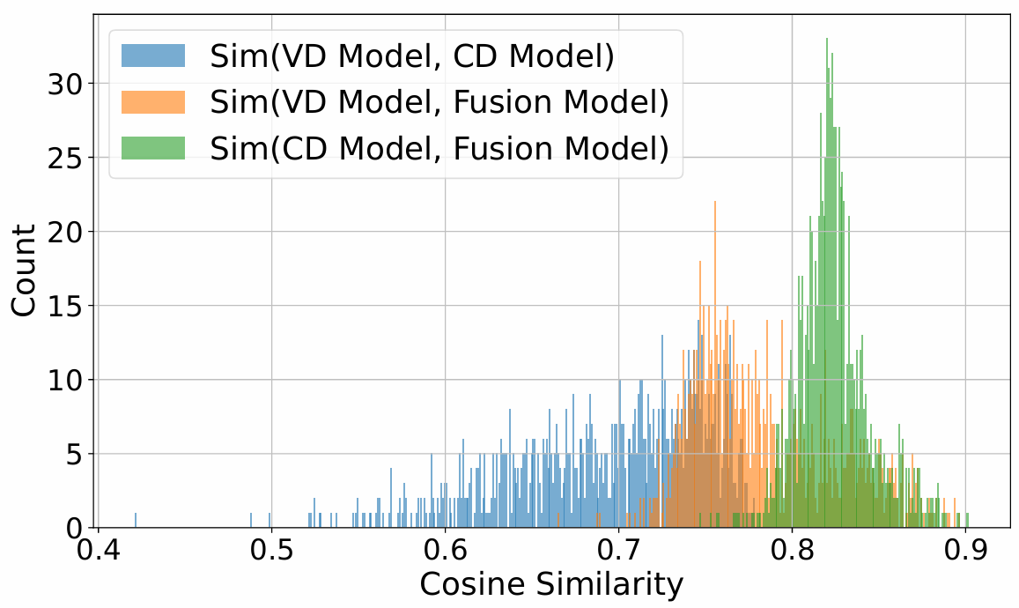
3. Study Result
RQ2: Performance of Multi-SE-Task Fusion within Same PL
The fused model behaves more similarly to fine-tuned models from tasks with stronger features (larger parameter changes).
Parameter change distributions vary greatly across different tasks.
Notes:
The figure on the left shows the distribution of fine-tuned parameter changes across different tasks. We can see that the distributions are significantly different across tasks..
The figure on the right shows the cosine similarity of hidden states among different models, including the vulnerability detection fine-tuned model, the clone detection fine-tuned model, and the fused model for program understanding tasks.
We find that the fused model behaves more similarly to the clone detection model.
Furthermore, clone detection has larger parameter changes than vulnerability detection. We refer to such tasks as strong-feature tasks.
Therefore, we can conclude that, in the multi-task fusion within same programming language, This explains why the performance of clone detection is good, while the performance of vulnerability detection drops substantially.

Slide 13
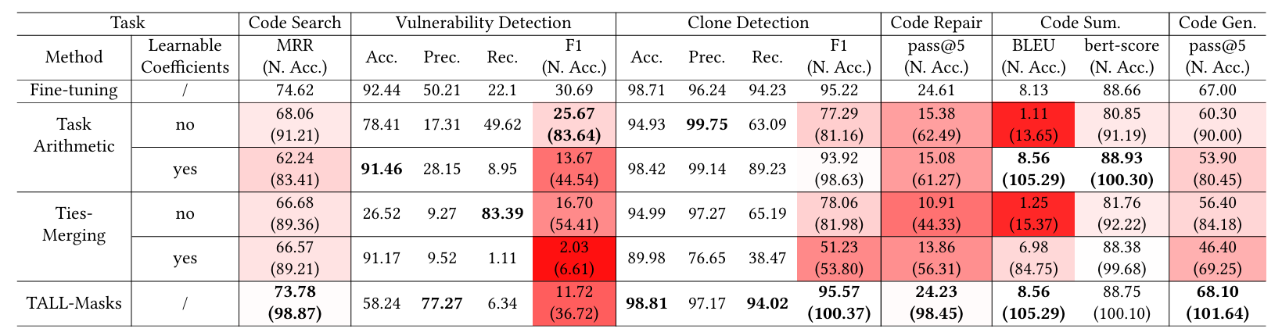
3. Study Result
RQ3: Performance of Multi-SE-Task Multi-PL Fusion
Almost all fusion methods experience significant performance drops on certain tasks.
TALL-Masks suffers a notable performance drop on vulnerability detection, while retaining nearly 100% of the fine-tuned model’s capability on other tasks.
Notes:
The table shows the results of merging three Java program understanding tasks and three Python program generation tasks.
We observe that almost all approaches suffer large performance drops on certain tasks. A possible reason is that different programming languages and different tasks introduce stronger feature conflicts.
For TALL-Masks, the performance drop on vulnerability detection is particularly large, it retains only 36% of the original fine-tuned performance.

Slide 14
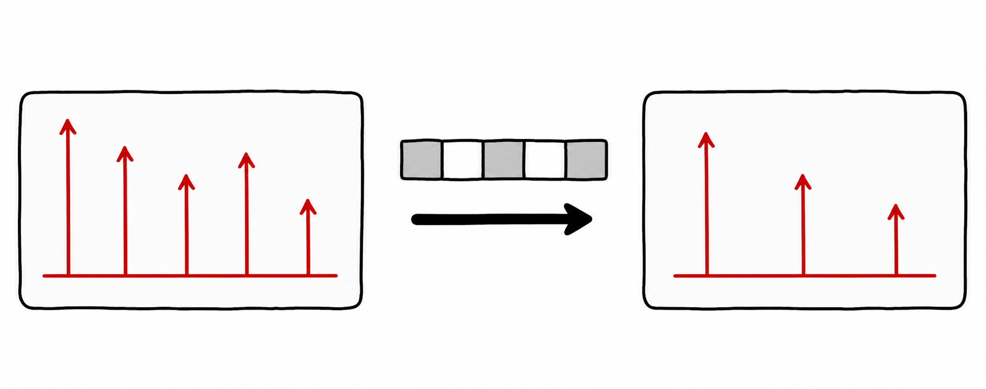
3. Study Result
RQ3: Performance of Multi-SE-Task Multi-PL Fusion
Notes:
To understand why TALL-Masks suffers large performance drop in some scenarios, we conduct a deep analysis.
Recall that TALL-Masks constructs a mask for each task to identify the most relevant parameters.

Slide 15
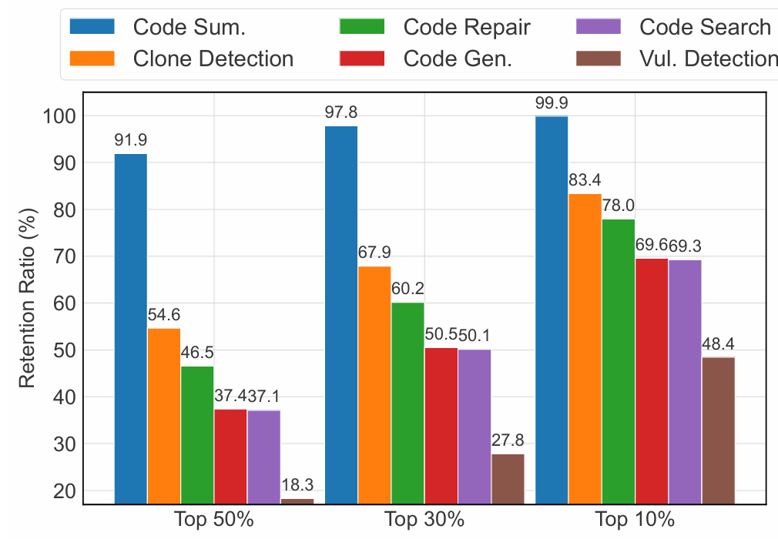
3. Study Result
RQ3: Performance of Multi-SE-Task Multi-PL Fusion
For TALL-Masks, on weak-feature tasks, the constructed masks fail to preserve important parameters effectively .
Notes:
We therefore study how well TALL-Masks preserves parameters with different levels of importance.
This figure shows the parameter retention rates for different languages and tasks in the multi-task, multi-language fusion setting.
We find that, for vulnerability detection, which is a weak-feature task, the retention rate of the top 10% largest parameters is very low. This indicates that the mask fails to effectively retain the most task-relevant parameters, and lead to performance degradation on these tasks.

Slide 16
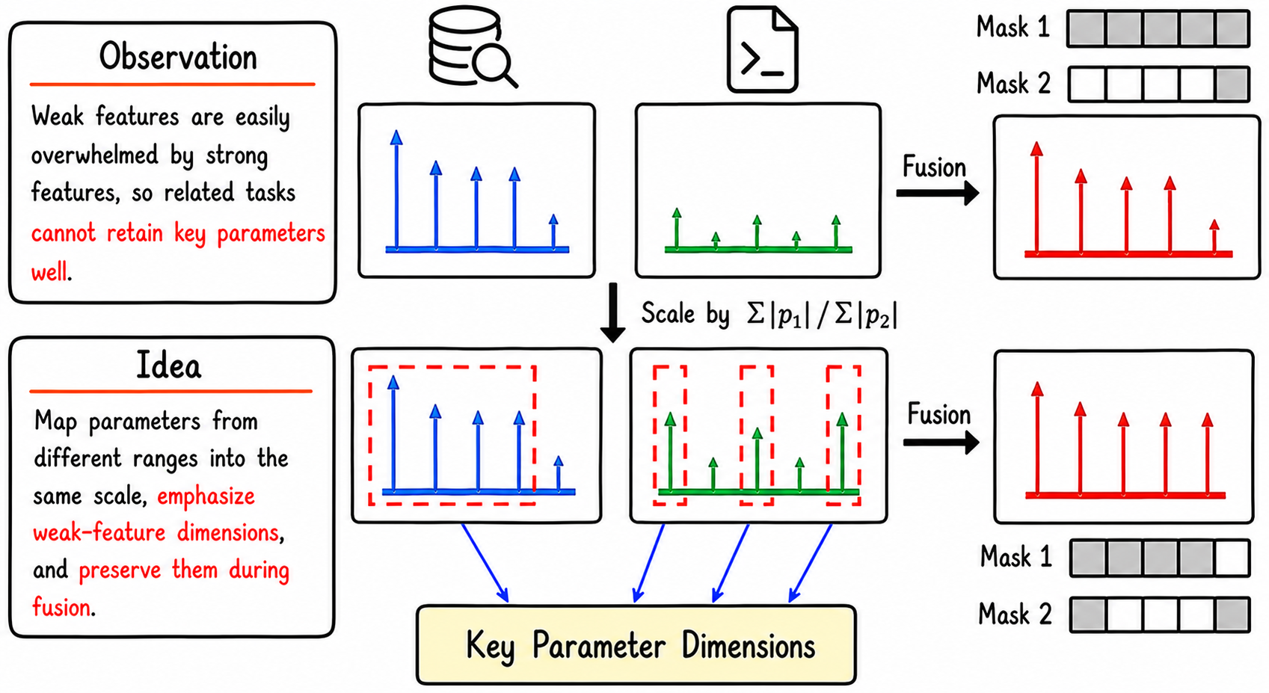
3. Study Result
RQ4: Enhancement Strategy (Scaling-Masks)
Notes:
Finally, we try to improve TALL-Mask to enhance its performance on weak-feature tasks, that is, tasks with smaller parameter changes.
Our key observation is that, during max fusion, weak features can be overwhelmed by strong features. As a result, the constructed mask cannot effectively locate the key parameter dimensions for weak-feature tasks.
Inspired by the feature normalization technique, our idea is to map the parameter ranges of different tasks to a same scale.
Specifically, we amplify weak features according to the ratio of their absolute values before fusion. Once the importance of weak features is increased, the mask can better identify them in the fused parameters.

Slide 17
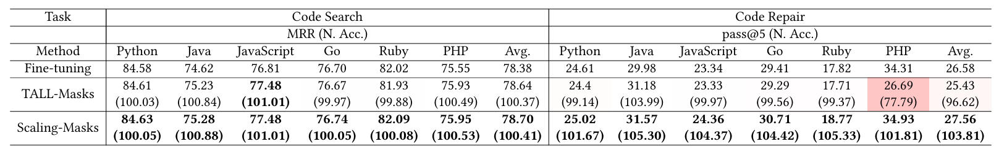
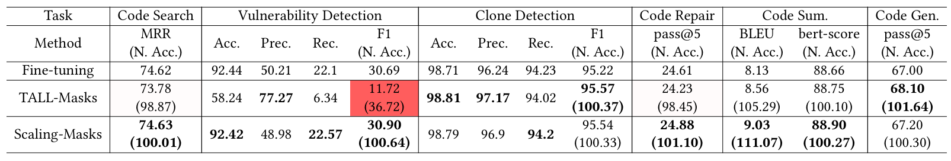
3. Study Result
RQ4: Enhancement Strategy (Scaling-Masks)
Performance of Multi-PL Fusion within Same Task
Performance of Multi-SE-Task Multi-PL Fusion
Scaling-Masks retains 100% of the original fine-tuned model’s performance across all tasks.
24.0%
63.4%
PHP
Vul. Detection
Notes:
The experimental results show that, under both the multi-language fusion setting and the multi-task, multi-language fusion setting, our approach retains 100% of the original fine-tuned performance.
Compared with TALL-Masks, our approach achieves fusion performance improvement with 24% on PHP in the code repair task and 63.4% in vulnerability detection.

Slide 18
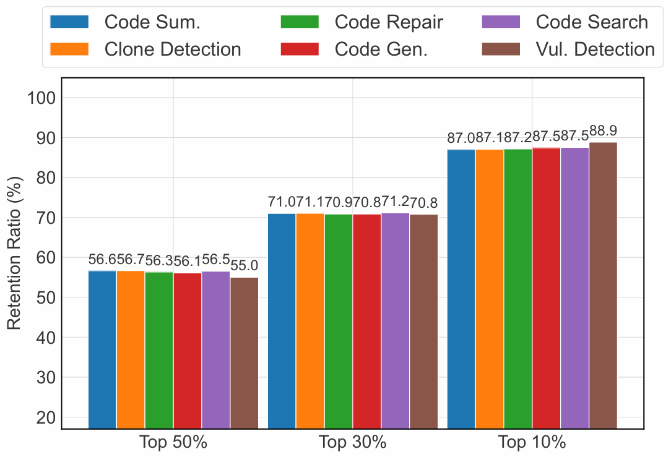
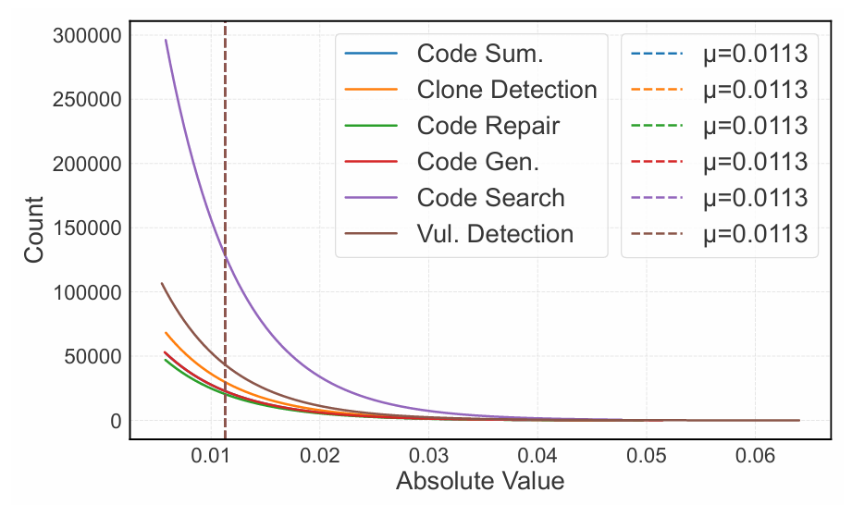
3. Study Result
RQ4: Enhancement Strategy (Scaling-Masks)
The normalized parameter distributions is more similar.
Key parameter retention rate is significantly improved.
Notes:
From these two figures, we can see that after normalization, the parameter distributions of different tasks become more similar.
Moreover, for all tasks, the retention rate of important parameters is significantly high.

Slide 19
Q & A
Please email qyg@nudt.edu.cn with your questions
The source code of this work is available at https://doi.org/10.5281/zenodo.19491719
Notes:
That’s all, Thank you for listening.

